Slide 1
Uber 2024 Ride Data Storytelling

Slide 2
Introduction:
The dataset contains detailed ride-sharing data from Uberoperations for the year 2024, providing rich insights into booking patterns, vehicle performance, revenue streams, cancellation behaviours, and customer satisfaction metrics.

Slide 3
Columns:
01
02
03
04
Booking Details
Customer & Driver Information
Booking ID, Date, Time, Booking Status (Completed, Cancelled, Incomplete, No Driver Found).
Customer ID
Cancellation indicators (Cancelled Rides by Customer, Cancelled Rides by Driver) and reasons.
Ride Information
Financial Data and Evaluation
Vehicle Type (Bike, Auto, Sedan, etc.)
Ride Distance
Pickup Location and Drop Location
Avg VTAT (Vehicle Time to Arrive), Avg CTAT (Customer Time to Arrive).
Booking Value ,
Payment Method,
Driver Ratings and Customer Ratings.

Slide 4

What are the different booking’s status?

Slide 5
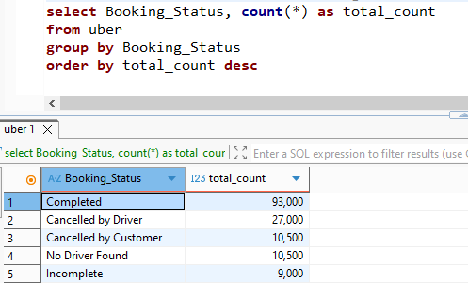
What is the count of each booking’s status?

Slide 6

What about the revenue?

Slide 7
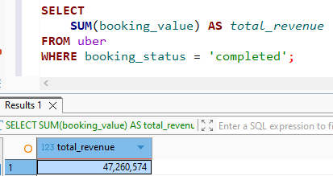
What is the total revenue earned from completed rides?

Slide 8
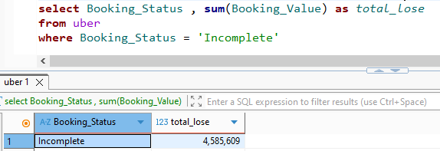
How much revenue is lost due to incomplete rides?

Slide 9

How many cancelled rides are there?

Slide 10
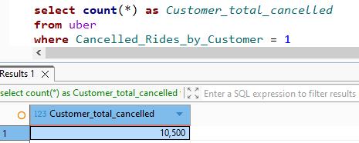
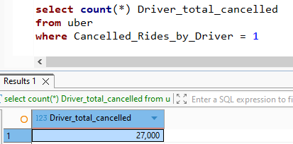
How many rides were cancelled by customers or drivers?

Slide 11
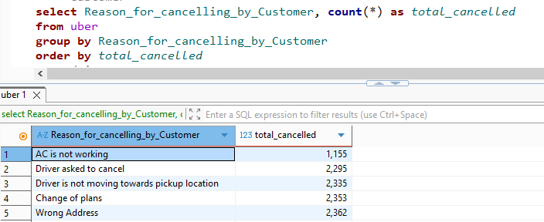
What are the top reasons for cancellation by customer?

Slide 12
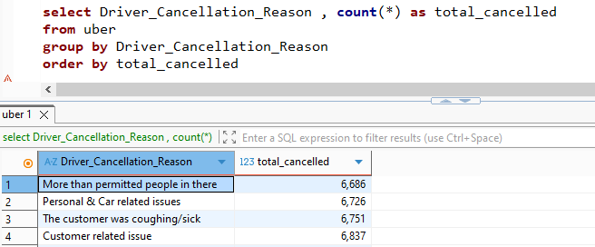
What are the top reasons for cancellation by driver?

Slide 13
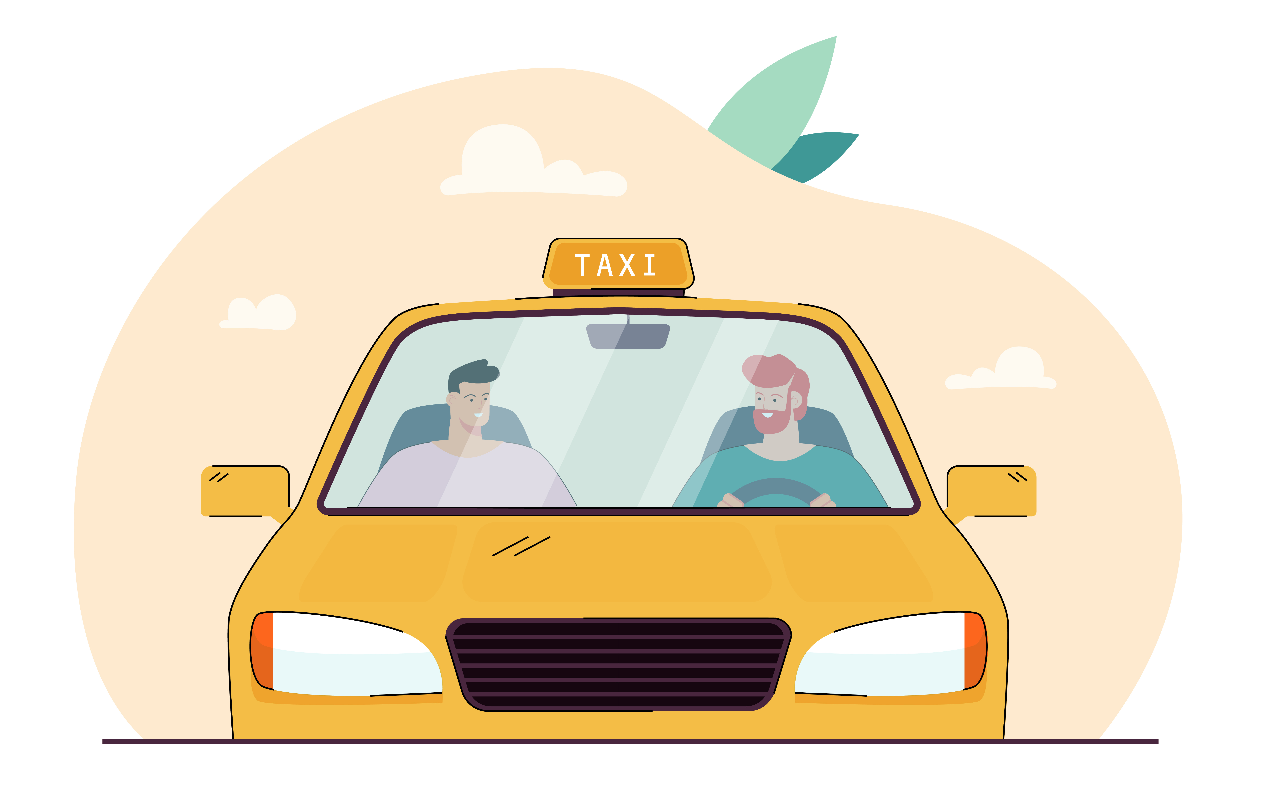
Which vehicle types are mostly used?

Slide 14
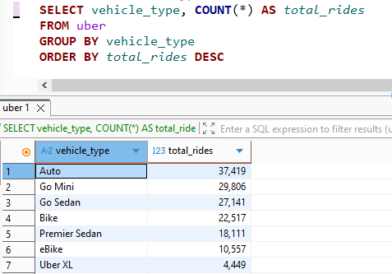
Which vehicle types are mostly used?

Slide 15
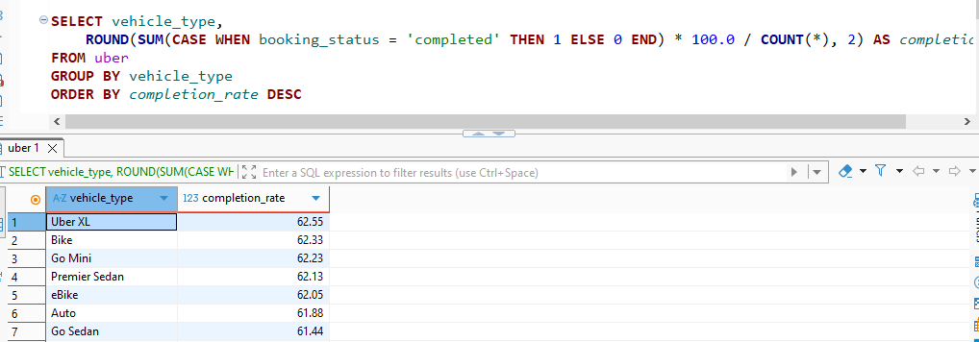
Which vehicle the highest completion rate?

Slide 16
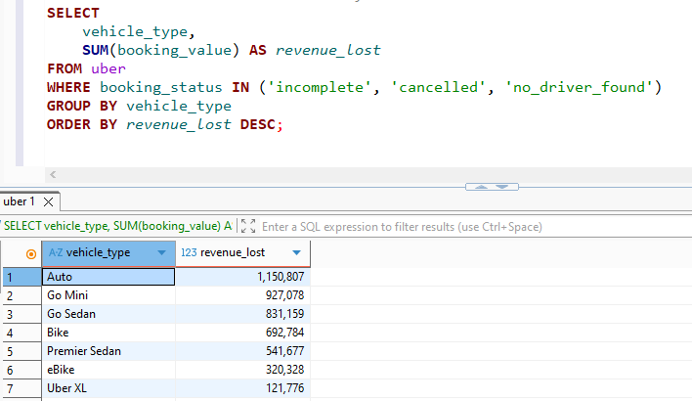
What is the total revenue lost by each vehicle?

Slide 17
Now, Let’s move to booking values and methods

Slide 18
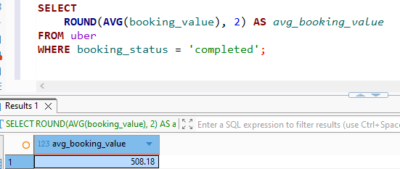
What is the average booking value?

Slide 19
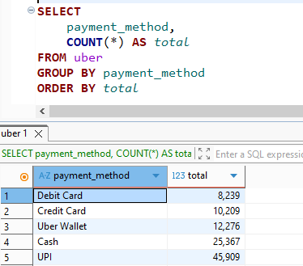
What are the most used payments methods?

Slide 20
What is the time trend for cancellation?

Slide 21
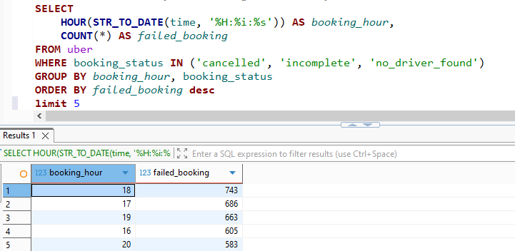
What times of day are bookings MOST likely to fail?

Slide 22
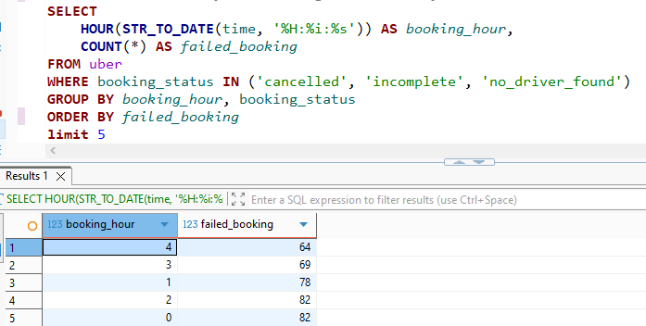
What times of day are bookings LEAST likely to fail?

